Slide 1
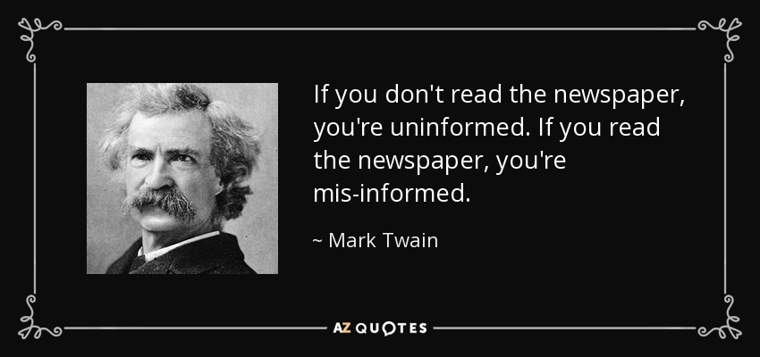
Fake News or World News
Notes:
With the overflowing of information in the current world , we often find it hard to discern between what is real and fake , what is true and false and what is the full story and selective story. Often , we will find rouge players using misleading words to mix into sentences to arouse sentiments or misinformed the public so that the desired reactions could be derived from their victims.
In this notebook , I had extracted datas from 2 subreddits post : r/fakwnews and r/World News. At the point of data extraction (Sep 2021) , with the controversy of many 'exciting' news and tweets from the previous POTUS (2016 - 2000) during election periods, as well as the recent US withdrawal from Afghanistan and the ongoing Covid19 Pandemic , there is no doubt there will be numerous posts that transient these 2 posts. The objective of this project is to experiment various modelling and processing technique , so that we are able to create well performed text processing model to better differentiate between fake news and real news.

Slide 2
Problem Statement
The objective of this project is to study binary classification modelling and language processing technique, so that we are able to better differentiate between fake new and world news.
Overall Workflow
Web Scrapping
Data Cleaning
Numerical Encoding
Creating Model
Model Evaluation
Next Step
Notes:
With the overflowing of information in the current world , we often find it hard to discern between what is real and fake , what is true and false and what is the full story and selective story. Often , we will find rouge players using misleading words to mix into sentences to arouse sentiments or misinformed the public so that the desired reactions could be derived from their victims. As Data Scientist , are will able to experiment various modelling and processing technique , so that we are able to create well performed text processing model to help the enmass to better differentiate between fake news and real news?

Slide 3
Model Overview
Models | Encoding Type | Description
Random Forest Classifier | Tokenisation | Text vectorization
Bi-Direction LSTM | Word Embedding | Creating own embedding
Universal Sentence Encoder | Word Embedding | Transfer Learning
Overall Workflow
Web Scrapping
Data Cleaning
Numerical Encoding
Creating Model
Model Evaluation
Model Evaluation

Slide 4

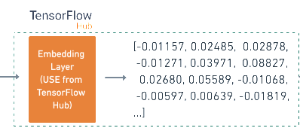



Overall Workflow
Web Scrapping
Data Cleaning
Numerical Encoding Words
Creating Model
Evaluating Model
ML Algo
Encoder
Decoder
Fake News?
World News?
Overall Workflow
Web Scrapping
Data Cleaning
Numerical Encoding
Creating Model
Model Evaluation
Next Step

Slide 5
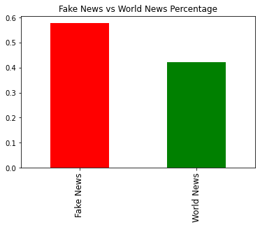
Web Scrapping
Fake News
1,500 Data Set (Original)
1,052 Data Set (After Clean)
World News
1,500 Data Set (Original)
794 Data Set (After Clean)
Time Between Scrape
10 second
57%
43%
Overall Workflow
Web Scrapping
Data Cleaning
Numerical Encoding
Creating Model
Model Evaluation
Next Step

Slide 6
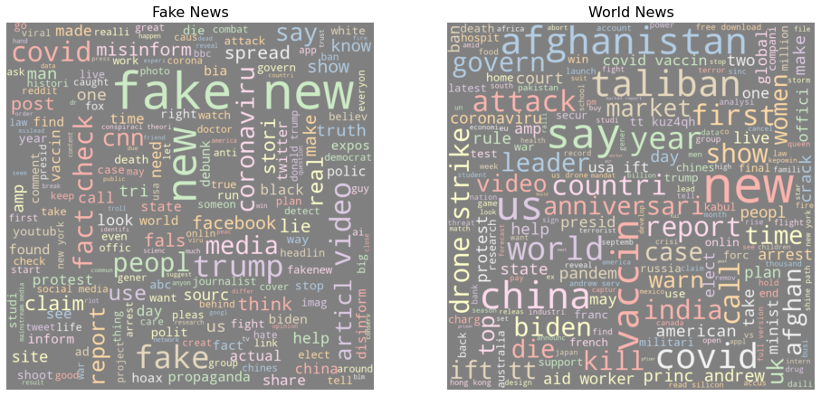
Data Pre-processing
Overall Workflow
Web Scrapping
Data Cleaning
Numerical Encoding
Creating Model
Model Evaluation
Next Step
Notes:
Remove numeric , remove punctuation , remove stop words , stem the words and joint them back

Slide 7
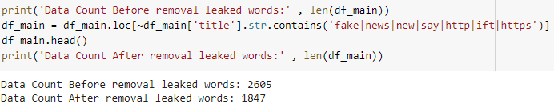
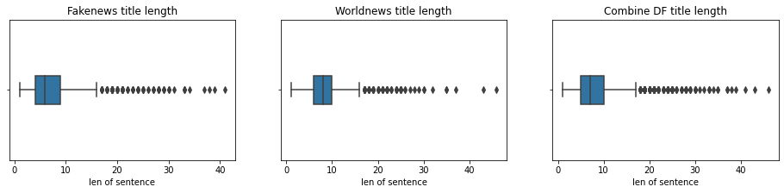
Data Pre-processing
Text Vectorize
Remove Noise & Leakage
Remove Short Sentence
Overall Workflow
Web Scrapping
Data Cleaning
Numerical Encoding
Creating Model
Model Evaluation
Next Step
Notes:
Remove numeric , remove punctuation , remove stop words , stem the words and joint them back

Slide 8
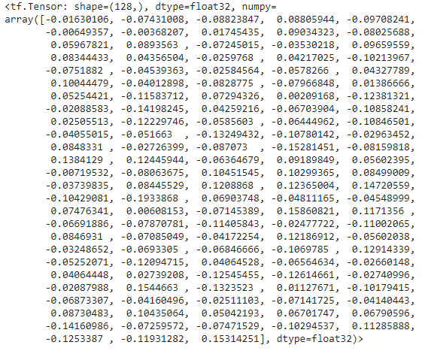
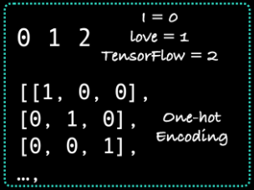
Numerical Encoding
Word Tokenization
Count Vectorizer
TFIDF Transformer
Word Embedding
Embedding Layer
Transfer Learning Pre-trained Embedding Layer
Overall Workflow
Web Scrapping
Data Cleaning
Numerical Encoding
Creating Model
Model Evaluation
Next Step
Notes:
Tokenisation – straight mapping from token to number
Embedding - richer representation of relation between tokens

Slide 9
Creating Model
Models | Encoding Type | Description
Random Forest Classifier | Tokenisation | Text vectorization
Bi-Direction LSTM | Word Embedding | Creating own embedding
Universal Sentence Encoder | Word Embedding | Transfer Learning
Overall Workflow
Web Scrapping
Data Cleaning
Numerical Encoding
Creating Model
Model Evaluation
Model Evaluation

Slide 10
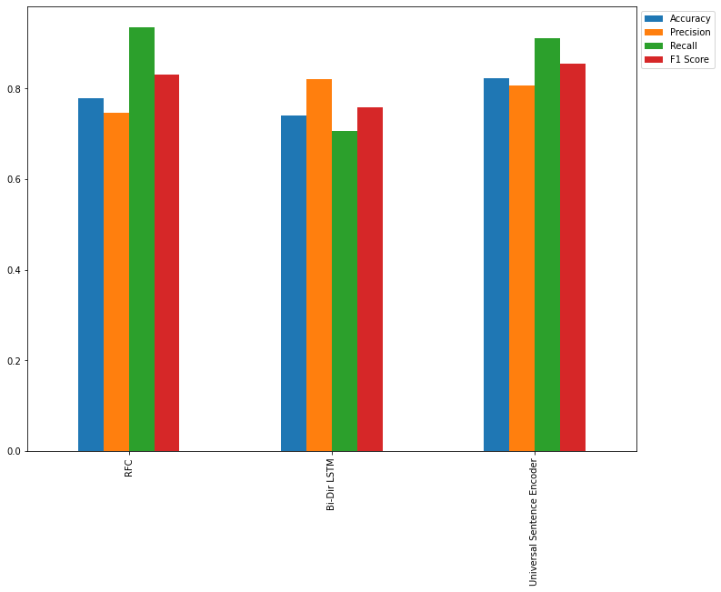
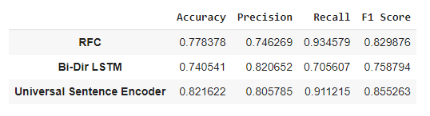
Model Summary
Overall Workflow
Web Scrapping
Data Cleaning
Numerical Encoding
Creating Model
Model Evaluation
Model Evaluation

Slide 11
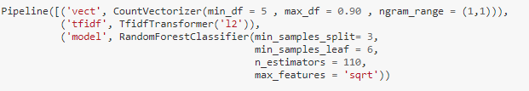
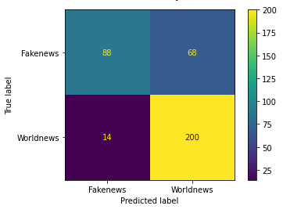
Random Forest Classifier
Overall Workflow
Web Scrapping
Data Cleaning
Numerical Encoding
Creating Model
Model Evaluation
Next Step

Slide 12
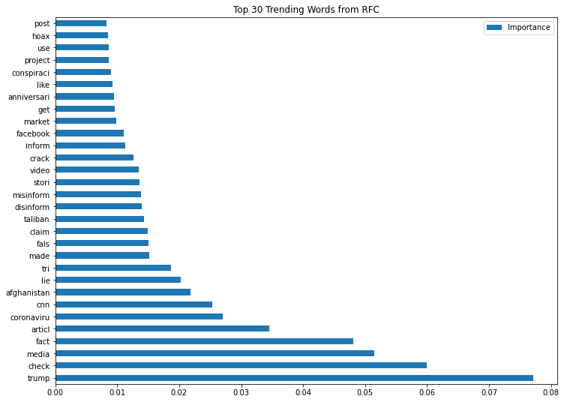
Random Forest Classifier
Overall Workflow
Web Scrapping
Data Cleaning
Numerical Encoding
Creating Model
Model Evaluation
Next Step

Slide 13
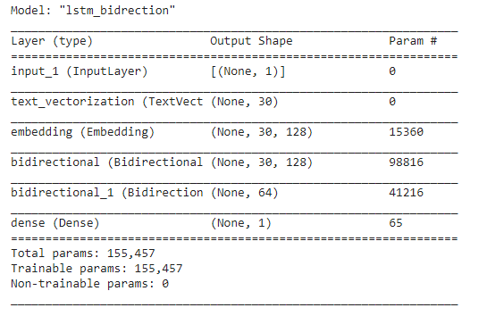
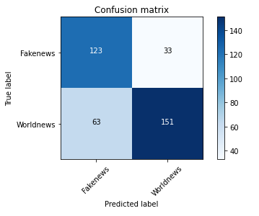
LSTM Bi-directional
Key Parameters
Max Vocab Length : 120
Max Length : 30
Pad to max token : True
Output dim : 128
Overall Workflow
Web Scrapping
Data Cleaning
Numerical Encoding
Creating Model
Model Evaluation
Next Step
Notes:
- Input layer parse through the text vectorizer layer , then the embedding layer , and few hidden layer of bi directional LSTM , then finally a single dense output (sigmoid)
- Output dim refer to the number of vector the word tried to find its relation with. Max Vocab length = word limit.
Perform well , but overfitted.
Observed to be performing worse after epoch increase
This is a base model , can be tuned further by changing the optimizer , more hidden layers

Slide 14
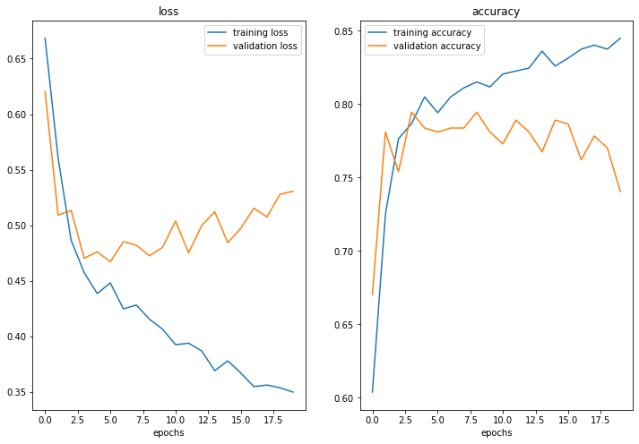
LSTM Bi-directional
Overall Workflow
Web Scrapping
Data Cleaning
Numerical Encoding
Creating Model
Model Evaluation
Next Step
Notes:
Input layer parse through the text vectorizer layer , then the embedding layer , and few hiiden layer of bi directional LSTM , the n finally a single dense output (sigmoid)
Output dim refer to the number of vector the word tried to find its relation with
Perform well , but overfitted.
Observed to be performning worse after epoch increase
This is a base model , can be tuned further by changing the optimizer , more hidden layers

Slide 15
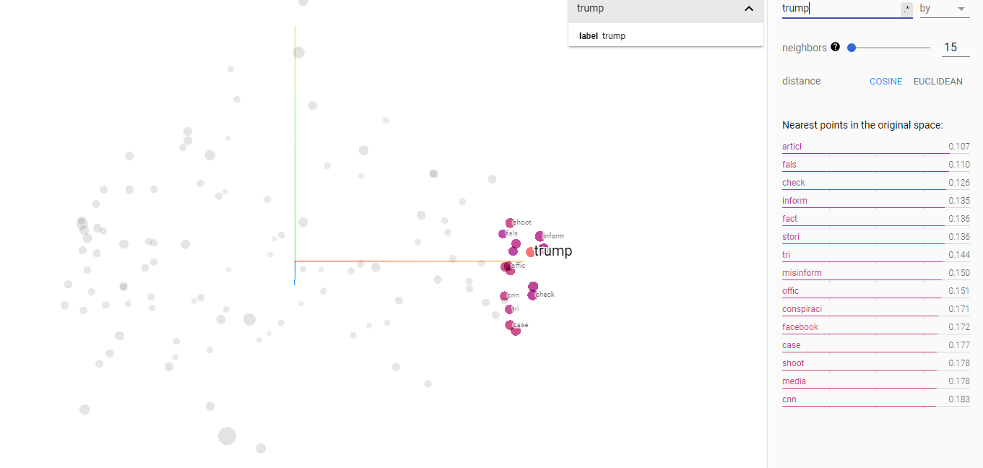
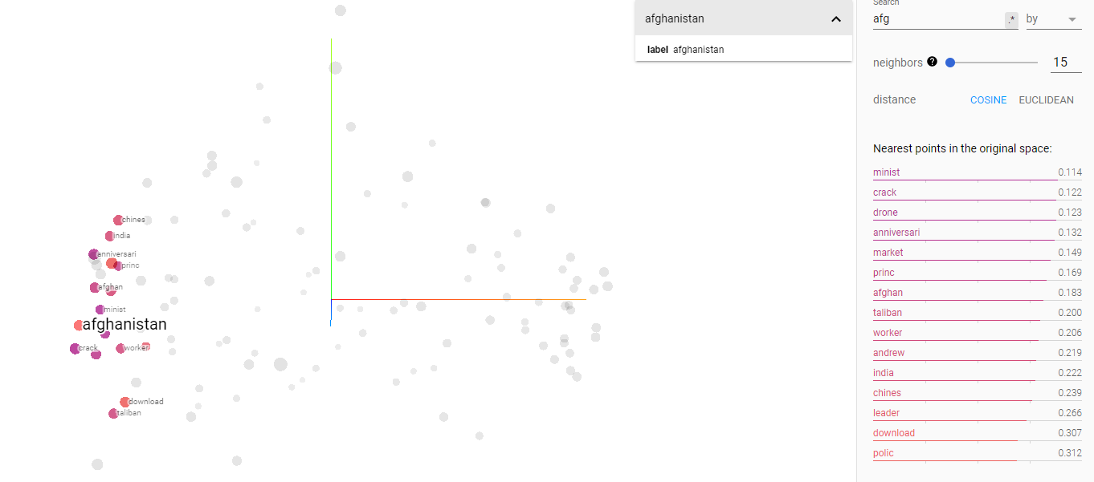
Visualising Word Embedding
120 Vocab : 45% Explained Variance
Overall Workflow
Web Scrapping
Data Cleaning
Numerical Encoding
Creating Model
Model Evaluation
Next Step
Notes:
The explained variance for this clustering is around 45% , using a vocab limit of 120.
The vocabs are more representative for our current quantity of data , which is around 2000 sentences.
2 clear distinct cluster could be observed : Trump on the fakenews side , and Afghanistan on the worldnews Side

Slide 16
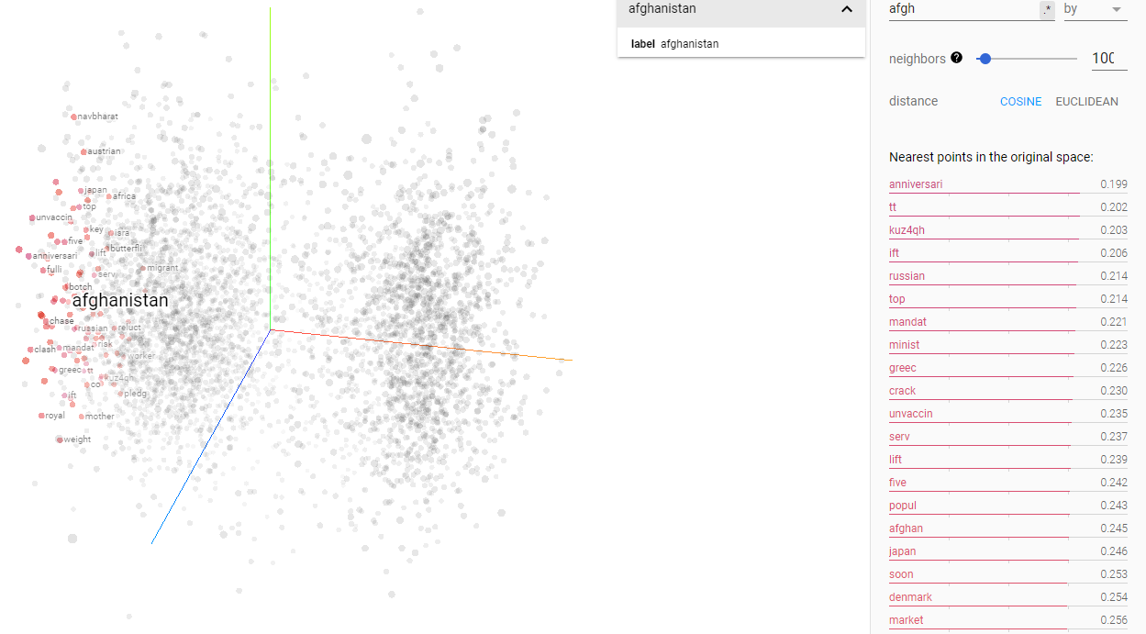
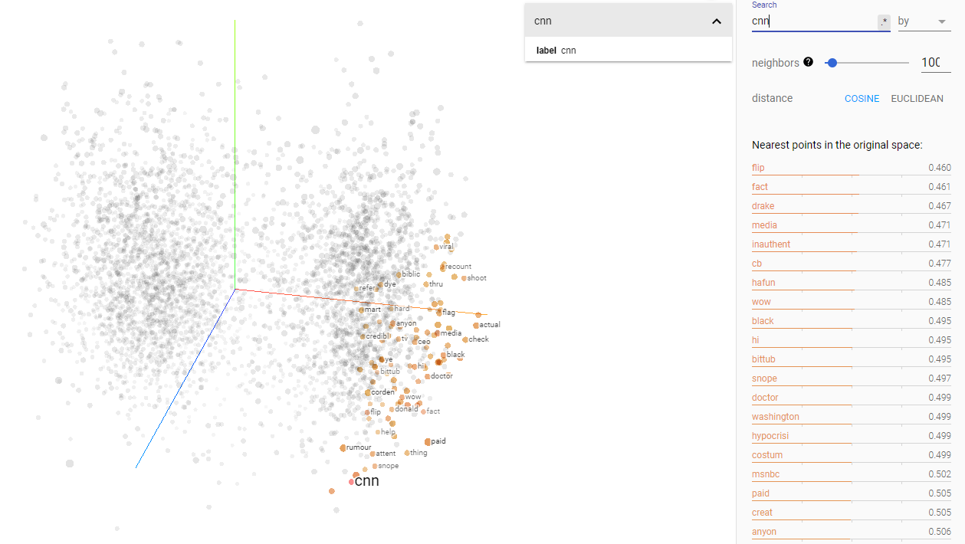
Visualising Word Embedding
6,000 Vocab : 22% Explained Variance
Overall Workflow
Web Scrapping
Data Cleaning
Numerical Encoding
Creating Model
Model Evaluation
Next Step
Notes:
* The explained variance for this clustering is around 22% , using a vocab limit of 6000.
* The vocabs are less representative for our current quantity of data , which is around 2000 sentences. The Vocab are more diluted across a smaller dataset , thus a lower explained variance observed.
* 2 clear distinct cluster could be observed : CNN on the fakenews side , and Afghanistan on the worldnews Side

Slide 17
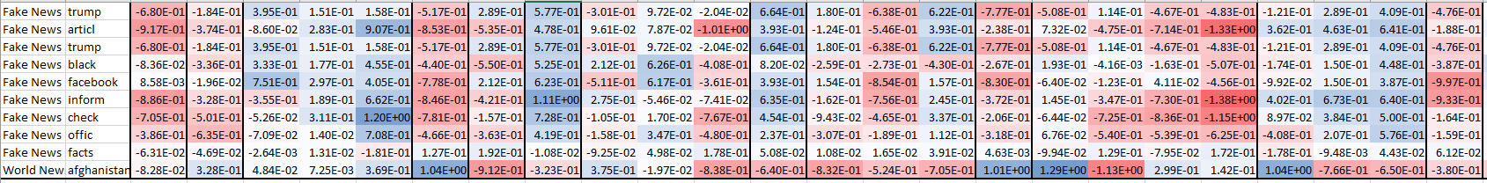
Visualising Word Embedding
Overall Workflow
Web Scrapping
Data Cleaning
Numerical Encoding
Creating Model
Model Evaluation
Next Step
Notes:
We could observed that for the 1st 9 words which are closely related to each other, their vectors for certain arrays are very similiar.
We could also observed that at the 10th row , which are not related to the 1st 9 words , often break away at certain arrays.

Slide 18
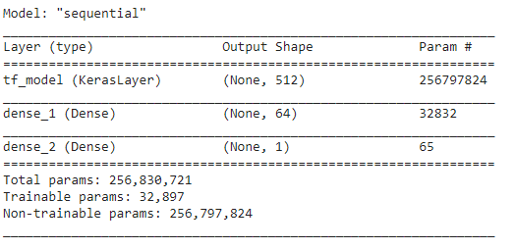
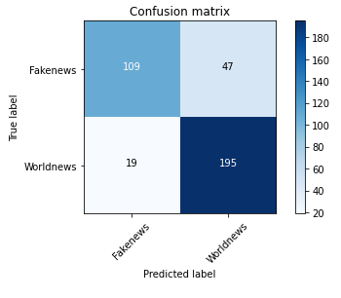
Universal Sentence Encoder
Key Parameters
Max Vocab Length : 120
Max Length : 30
Embedding Layer : USE Default
Overall Workflow
Web Scrapping
Data Cleaning
Numerical Encoding
Creating Model
Model Evaluation
Next Step

Slide 19
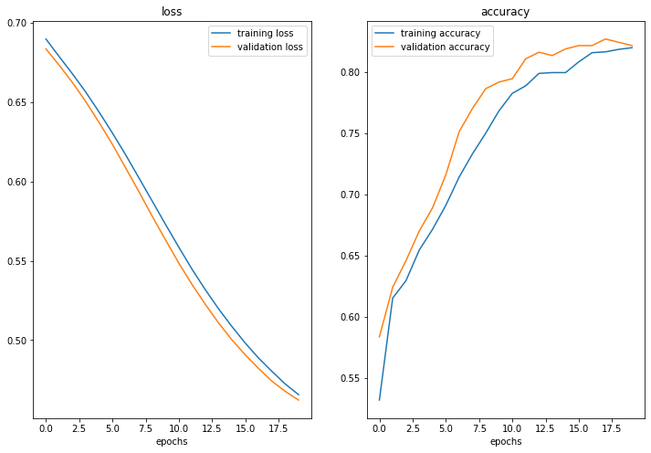
Universal Sentence Encoder
Overall Workflow
Web Scrapping
Data Cleaning
Numerical Encoding
Creating Model
Model Evaluation
Next Step
Notes:
# We could observed that for this USE Model , the model is performing quite well with the validation accuracy scoring better than the training.
# The validation accuracy starts to pleateau around 0.82 , however it is still projecting in the right direction.
# Also it could be observed that as the number of epochs increase, the loss for the validation started decrease as well.
# We could increase number of epochs and fine tune the learning rate to experiment further.

Slide 20
Model Evaluation
Overall Workflow
Web Scrapping
Data Cleaning
Numerical Encoding
Creating Model
Model Evaluation
Model Evaluation

Slide 21
Conclusion & Next Step
Insights
Slightly confused due to some words.
Limitation
Limitation of word vocab due to dataset.
Improving Model Score
Experiment other pretrained embedding layer (BERT , GLoVe)
More Quality Dataset.
Generally perform well ~80% accuracy , F1 Score
Other Application
Original Objective to classify fake or news.
Expand to other social media platform.
Depression , suicidal notes.
Overall Workflow
Web Scrapping
Data Cleaning
Numerical Encoding
Creating Model
Model Evaluation
Model Evaluation
Notes:
Insights
Our models performed relatively well in differentiating between post from fake news and world news. The 3 models performed consistently with accuracy between 78% - 83% and F1 score of 83% - 86% , with the transfer learning USE outperforming amongst all.
The differences or the part where the models are confused is probably due to common word associated to both side of the posts such as US , death , which is linked to the Afghan withdrawal , as well as Donald Trump.
Current Limitation
As we could see from our word embedding , due to the limited amount of dataset at 2,000 dataset , the number of vocabs we had limited is set at 120 so as not to dilute the explained variance of the features. (Explained variance reduced to 22% as we increase the vocab limit to 6,000) If we do have more dataset , we could explore more relevant vocabs and have a better representation of the current challenges on various social media outlet, such as twitter , facebook or any popular forum , as a well as better cross studies on how effective are the fake words or fake posts arousing sentiments , moods and actions.
Next Steps in improving model score
Try replacing the TensorFlow Hub Universal Sentence Encoder pretrained embedding for the TensorFlow Hub BERT.
Experimenting with the pretrained GloVe embeddings.
Getting more dataset
Getting more quality dataset. For example , can we trained our model on actual world and fakes news first before using it to predict on these social media posts.
Next Steps in model application
Although the objective of this project was to attempt to explore techniques and model to classify posts from reddit, this could be further extended to more social mediam outlet such as twitter , facebook or relevant forums to assist in flushing out malicious fake and misformed news. This could also be further extended to other application as well such as detecting potential depression and suicidal posts

Slide 22
APPENDIX
Overall Workflow
Web Scrapping
Data Cleaning
Numerical Encoding
Creating Model
Model Evaluation
Model Evaluation

Slide 23
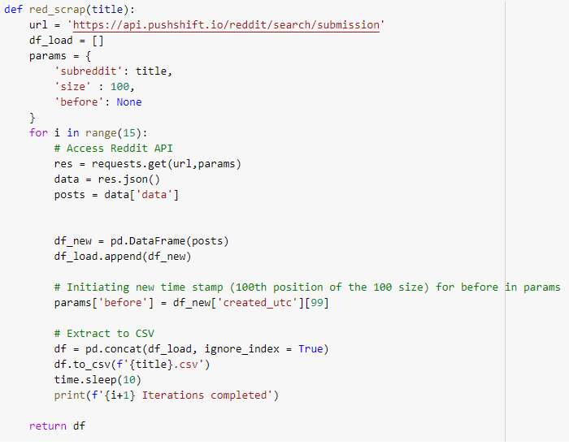
Web Scrapping
Overall Workflow
Web Scrapping
Data Cleaning
Numerical Encoding
Creating Model
Model Evaluation
Model Evaluation

